Slide 1
Oauth 2

Slide 2
Oauth 2
Introduction
OAuth 2.0, which stands for “Open Authorization”, is a standard designed to allow a website or application to access resources hosted by other web apps on behalf of a user.

Slide 3
Oauth 2
Roles of Oauth 2
OAuth defines four roles:
Resource Owner: The resource owner is the end user who authorizes an application to access their account.
Client: The client is the application that wants to access the user’s account. Before it may do so, it must be authorized by the user
Resource Server: The resource server manages the Resource owned by user
Authorization Server: The authorization server verifies the identity of the user then issues access tokens to the application.

Slide 4
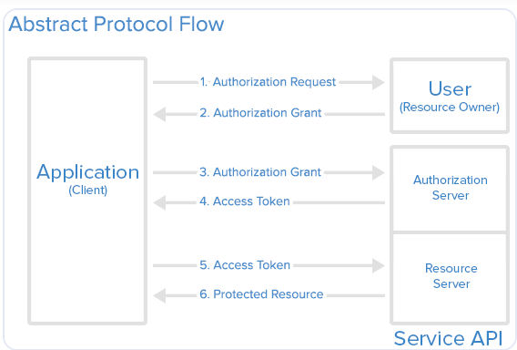
Oauth 2
Work flow

Slide 5
Oauth 2
Work flow steps
The application requests authorization to access resources from the user
If the user authorized the request, the application receives an authorization grant
The application requests an access token from the authorization server (API) by presenting the authorization grant
If the authorization grant is valid, the authorization server (API) issues an access token to the application. Authorization is complete.
The application requests the resource from the resource server (API) and presents the access token for authentication
If the access token is valid, the resource server (API) serves the resource to the application

